Slide 1
SQL Agent for Football Data
By Jacob Poore and Arian Zarazua

Slide 2
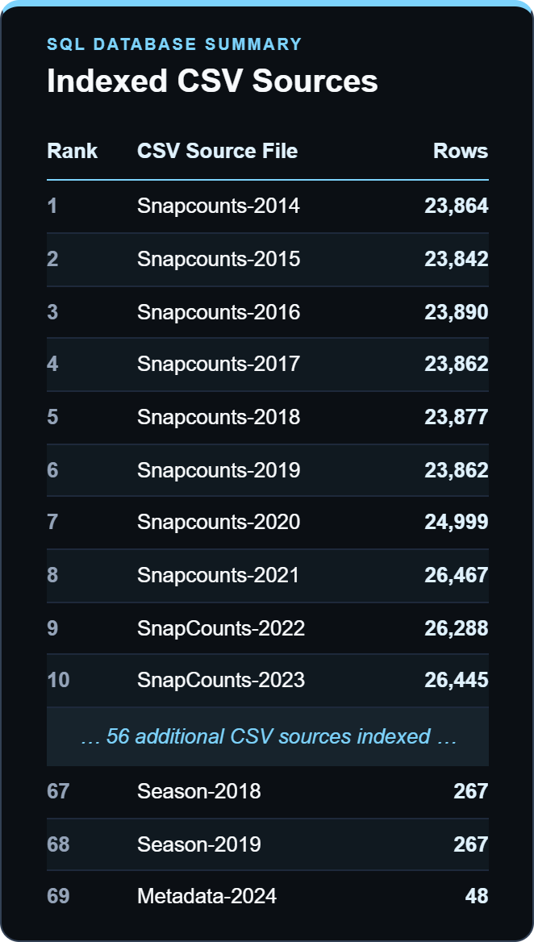
Motivation and Introduction
Sports analytics often encompasses millions of observations across hundreds of datasets, creating a difficult barrier to entry
Manually creating SQL queries are often difficult
Utilizing automated agents for sports analytics enables immediate output of time-sensitive sports analytics

Slide 3
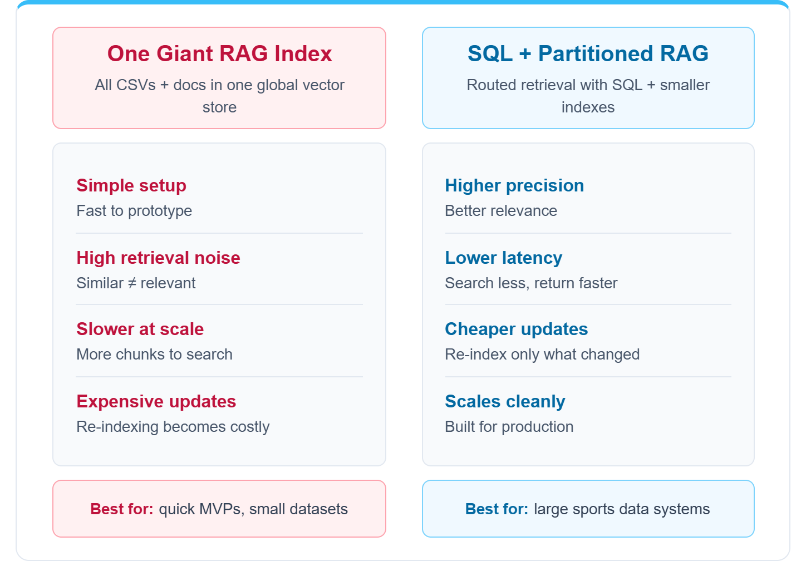
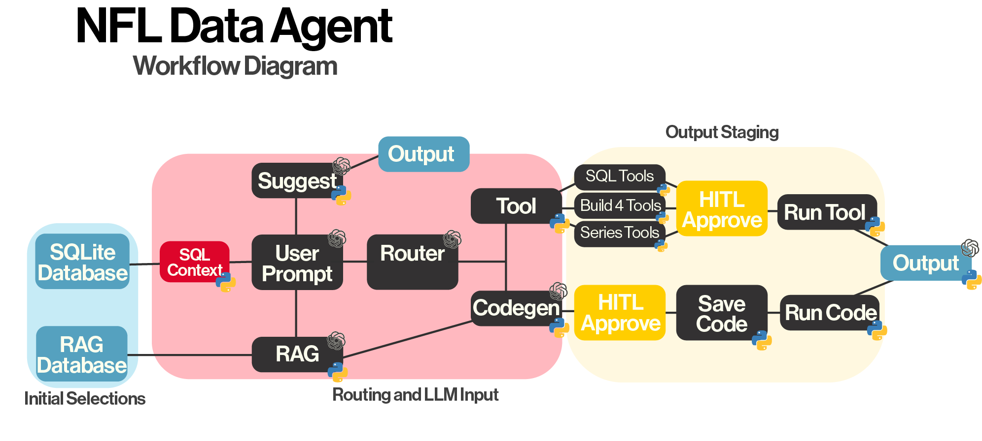

Slide 5
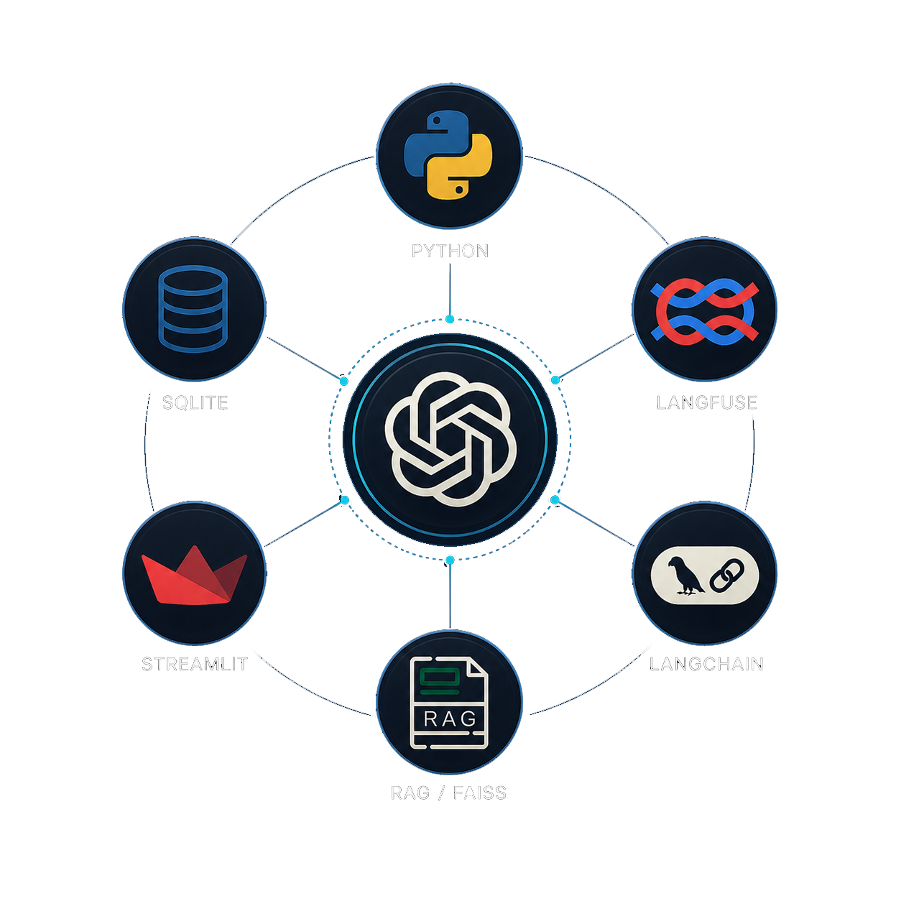
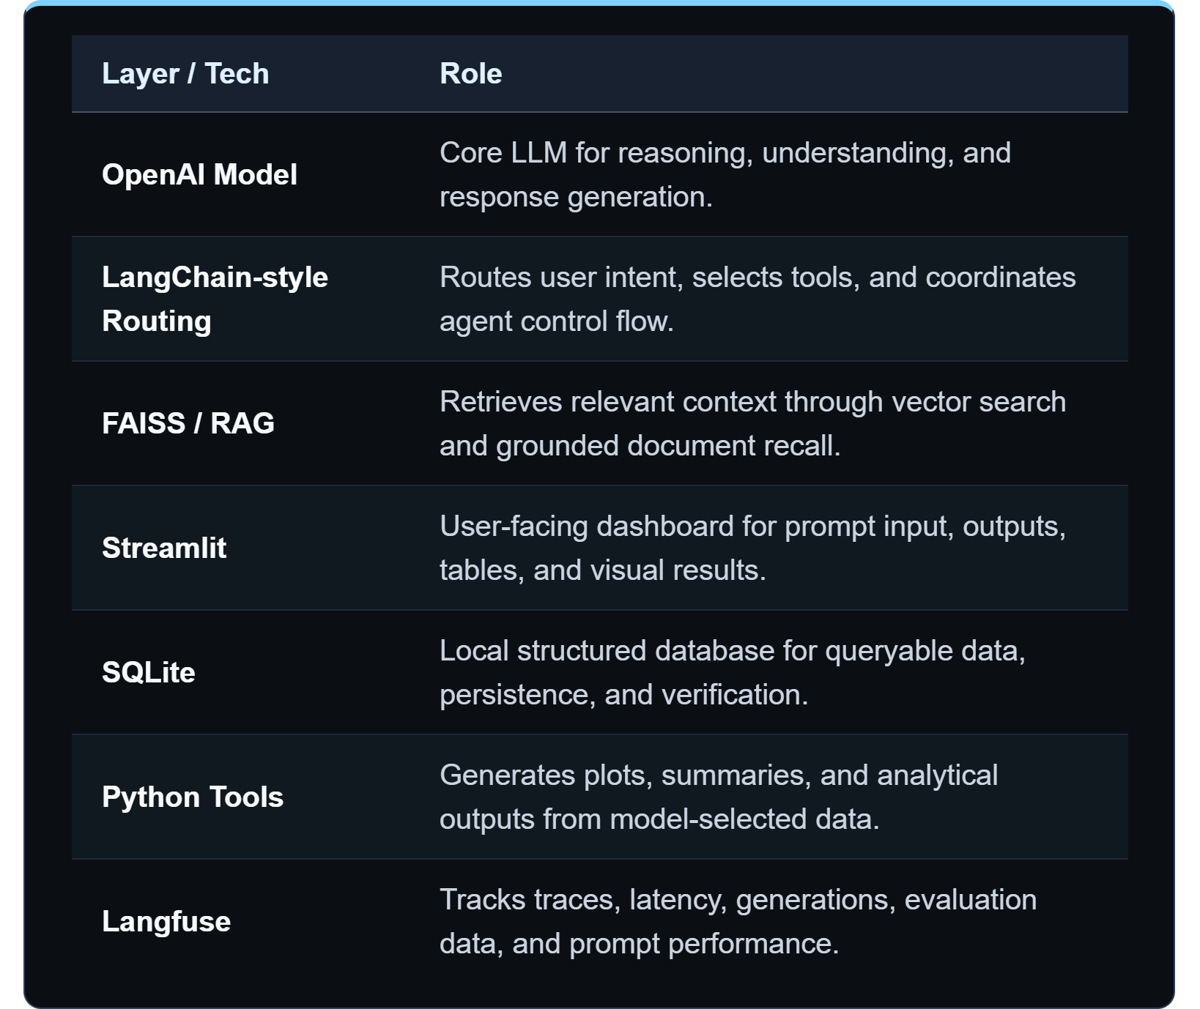
Tech Stack

Slide 6
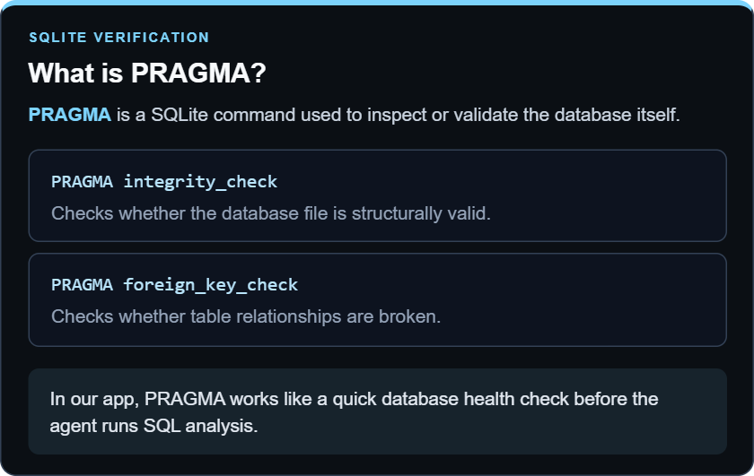
SQLite Implementation
The agent takes in CSV files and rebuilds a database locally on each agent initialization rather than as a persistent production data layer
We developed SQL native tools designed for querying our SQLite database
SQL Context is generated and passed into the LLM for tool routing

Slide 7
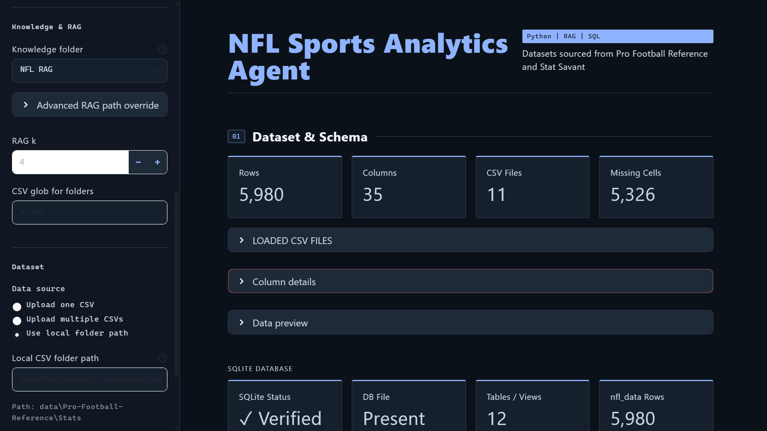
LIVE Demo

Slide 8
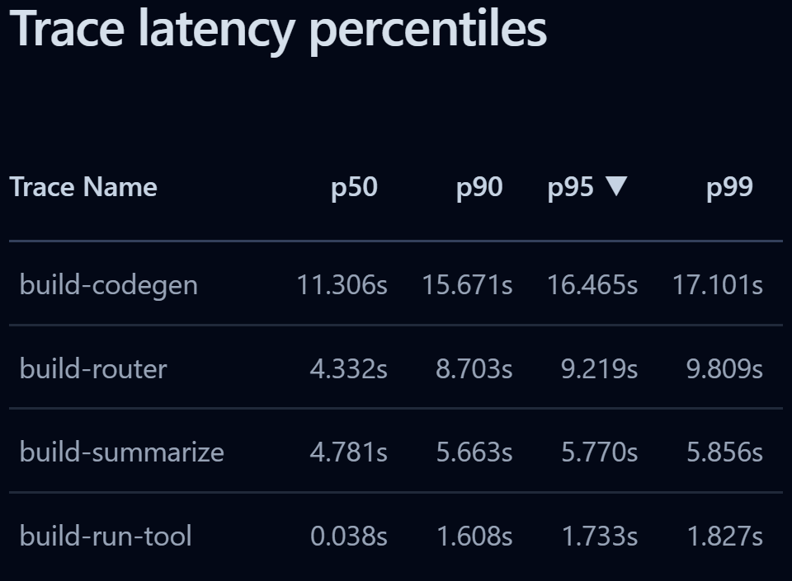
Testing & Validation
The agent can interpret natural language for the variables of interest without the need for exact variable names
(passing yards = pass_yds)
Latency:
11.31s 15.67s 17.10s
P50 p90 p99
The slowest latency for agent execution is only 5.70 seconds slower than the median
This shows that our model can reliably run analyses without stalling or delays
Notes:
build-codegen: The code-generation stage where the model produces executable Python or SQL for analysis.
ChatOpenAI: The core LLM call where the OpenAI model generates the main response or reasoning output.
RunnableSequence: The full chained execution of sequential LangChain steps combined into one pipeline.
build-summarize: The summarization stage where the model condenses outputs into a concise user-facing explanation.
build-router: The routing stage where the agent determines which tool or workflow path to send the query through.
build-toolplan: The planning stage where the agent decides which tools to call and in what order.
StrOutputParser: The parsing step that converts raw model output into plain structured text.
ChatPromptTemplate: The prompt-construction step where the final formatted input is assembled before being sent to the model.

Slide 9
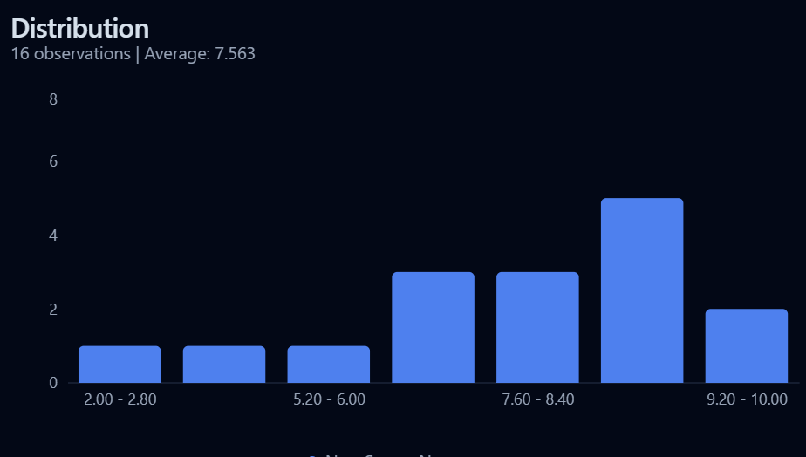
Testing & Validation Continued
Scoring:
Average Score: 7.563
A score of 10 means perfect results where the user (us) was 100% satisfied with the agent workflow, tool usage, and result
A score of 1 is assigned when the agent fails to run or execute the user prompt
Notes:
build-codegen: The code-generation stage where the model produces executable Python or SQL for analysis.
ChatOpenAI: The core LLM call where the OpenAI model generates the main response or reasoning output.
RunnableSequence: The full chained execution of sequential LangChain steps combined into one pipeline.
build-summarize: The summarization stage where the model condenses outputs into a concise user-facing explanation.
build-router: The routing stage where the agent determines which tool or workflow path to send the query through.
build-toolplan: The planning stage where the agent decides which tools to call and in what order.
StrOutputParser: The parsing step that converts raw model output into plain structured text.
ChatPromptTemplate: The prompt-construction step where the final formatted input is assembled before being sent to the model.

Slide 10
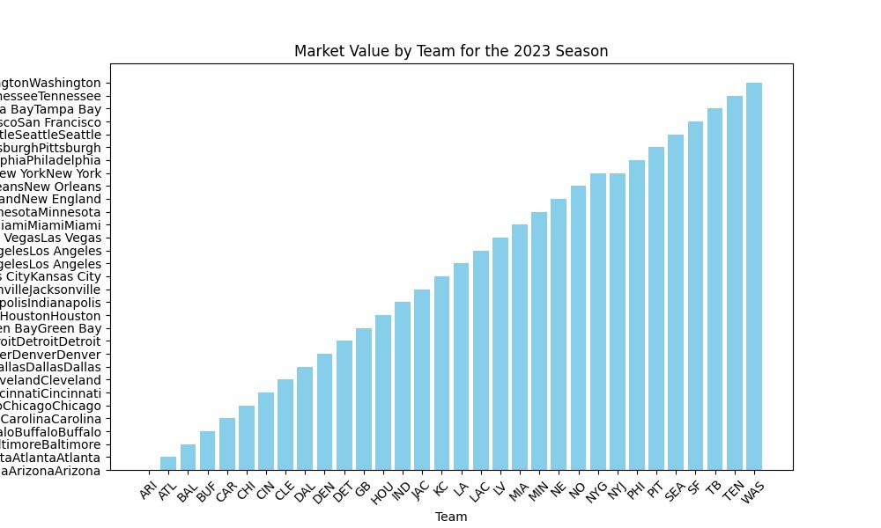
Challenges & Limitations
Aligning natural-language intent with exact schema semantics
Preventing valid-looking code from producing invalid analysis
RAG still needs stronger dataset-specific operational knowledge. In some cases, this is even hurtful for our analysis
Error: Agent was unable to sort by market value due to misunderstand data set schema
Solution: Better utilize RAG so the agent is better aware of vague user prompts

Slide 11
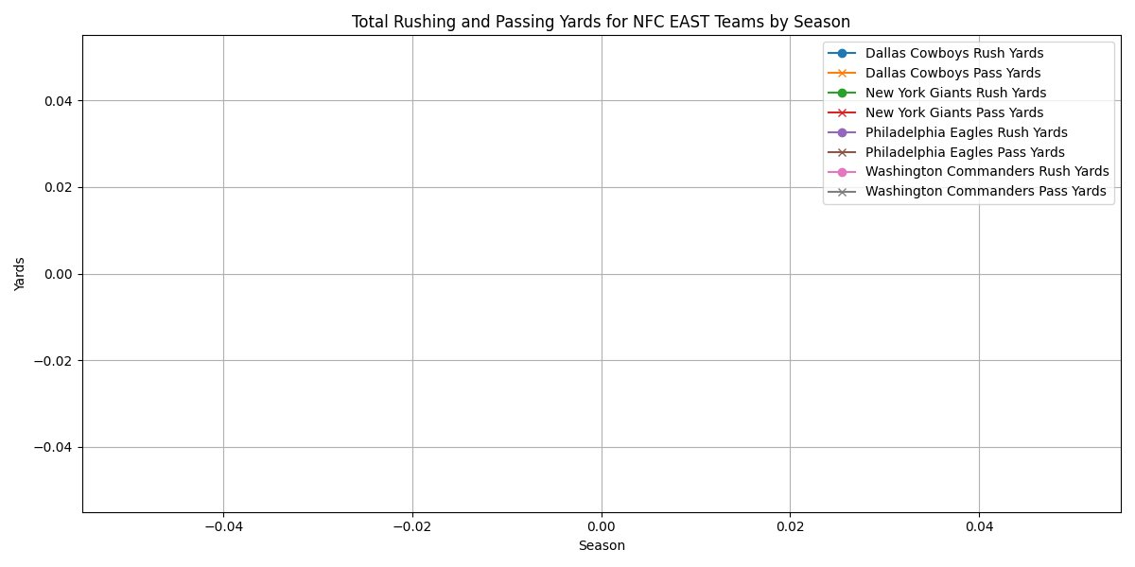
Additional Challenges
SQLite is strong for local structure analysis, but it’s not a distributed database or suitable for a long-term multi-user backend
RAG interference leads to occasional memory disruption, causing the model to lose that feature
Error: There was an error with Codegen filtering
Solution: Improve the filtering tools in the agent

Slide 12

Next Steps
Migrate to PostgreSQL to support concurrent users and enterprise-level access control.
Add more visualization and analytical tools
Improving RAG to prevent memory interference and training it for data specific operational knowledge

Slide 13

Summary
We built a Streamlit-based NFL analytics agent with Python tools, custom routing, Langfuse tracing, and SQLite
Reliability depends on schema awareness and pre-execution validation
RAG must contain concrete operational knowledge, not only workflow guidance

Slide 14
Questions?

